Slide 1
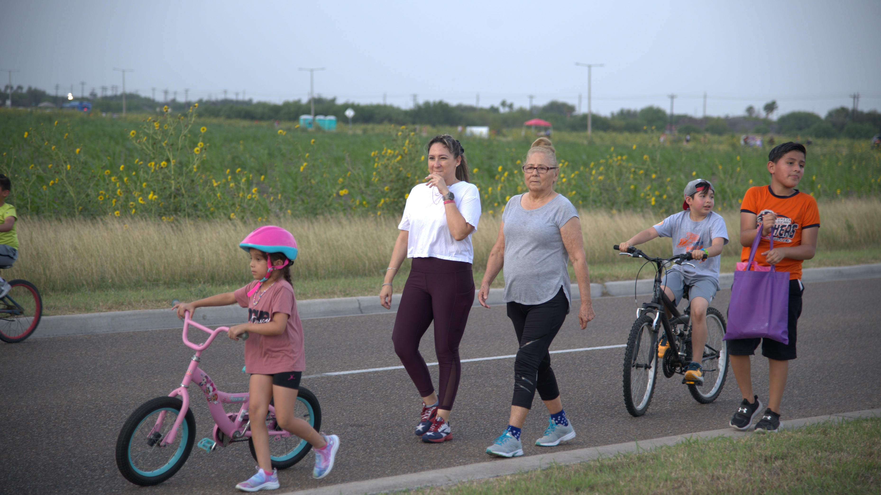
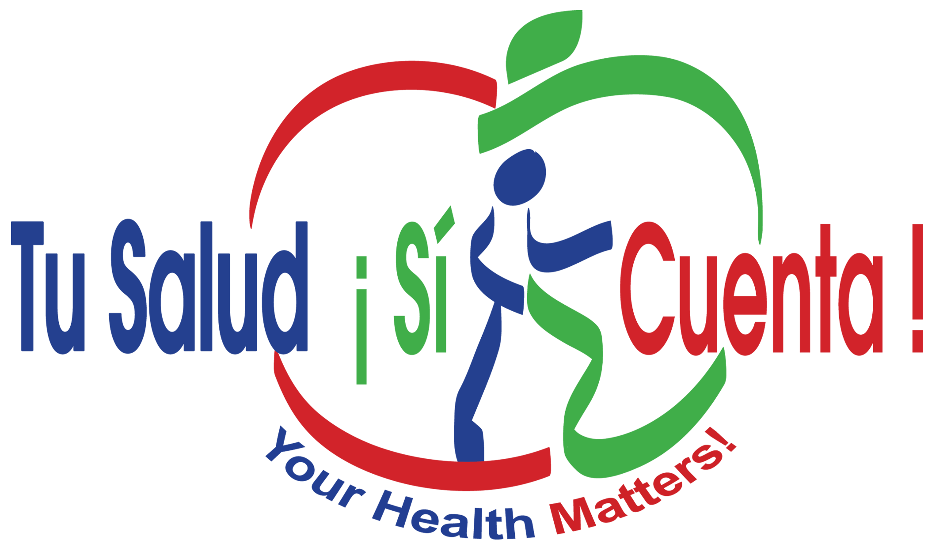

Slide 2
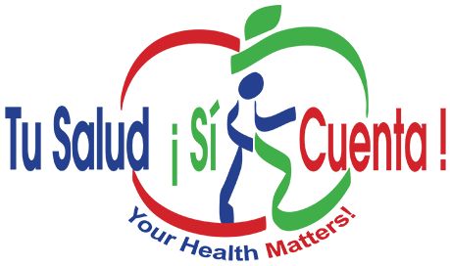
TSSC Campaign Exposure Related to Meeting Physical Activity Guidelines and Increased Portions of Fruits and Vegetables
Sample of 1438 Cameron County Hispanic Cohort participants who may or may not have exposure to the TSSC Campaign.
After adjusting for gender, age, marital status, educational attainment, language preference, health insurance, and diabetes diagnosis,
the strongest association for meeting PA guidelines was exposure to the CHW discussions and radio messages (adjusted OR=3.83; 95% CI= [1.28, 6.21]; p=0.0099).
We found that a combination of CHW discussions with any other component of the campaign increased odds of meeting PA guidelines (adjusted OR=2.8; 95% CI= [1.2, 6.2]; p=0.0156).
The strongest association for eating more portions of fruits and vegetables was exposure to radio and TV messages (adjusted RR=1.30; 95% CI= [1.02, 1.66]; p= 0.0338) compares to those who report no exposure. Participants consumed 30% more portions.
Reininger, B.M., Mitchell-Bennett, L., Lee, M., Gowen, R. Z., Barroso, C. S., Gay, J. L., & Saldana, M. V. (2015). Tu Salud,¡Si Cuenta!: Exposure to a community-wide campaign and its associations with physical activity and fruit and vegetable consumption among individuals of Mexican descent. Social Science & Medicine, 2015 Oct; 143, 98-106. [doi: 10.1016/j.socscimed.2015.08.029. PMID: 26347959 PMCID: PMC4642277]

Slide 3
Home Visit Interventions by Community Health Workers
Behavioral Intervention Trial of 500 Mexican Americans (n=250 intervention) (n=250 standard care). Intervention include 6 monthly CHW visits including education, motivation and support for lifestyle change.
Intervention participants were more likely to meet PA guidelines at 6 months (AOR=2.02, 95% CI=1.25, 3.26) than standard care, but the significance was not maintained at 12 months (AOR=1.53, 95% CI=0.92, 2.53).
CHW intervention content changed behaviors initially, however, long-term intervention strategies to support maintenance are needed.
Vidoni, M., Lee, M., Mitchell-Bennett, L, Reininger, B.M. (2019). Home Visit Intervention Promotes Lifestyle Changes: Results of a Randomized Controlled Trial in Mexican Americans. American Journal of Preventive Medicine 2019 Nov; 57(5): 611-620. Epub 2019 Sep 27. [doi: 10.1016/j.amepre.2019.06.020 PMID: 31564601]

Slide 4
Exposure to TSSC increases PA and Decreases Sedentary Behavior
Randomly sampled participants from intervention community (n=399) and comparison community (n=400) were surveyed.
Used International Physical Activity Questionnaire.
Intervention community exposed to 5 years of TSSC campaign (survey conducted in 2010).
Compared to comparison community, the intervention community had 3 times the odds of meeting PA guidelines (Adjusted OR [AOR] = 3.01, 95% CI = 1.85-4.88, p < .05)
Compared to comparison community, the intervention community had 2 times lower odds of excessive sedentary behavior (AOR = 0.46, 95% CI = 0.30-0.70, p < .05).
Exposure to newsletters, CHW discussions, TV segments from the campaign had 5 times the odds of meeting PA and 3 times lower odds of excessive sedentary behavior.
Heredia NI, Lee M, Reininger BM. (2017). Exposure to a community-wide campaign is associated with physical activity and sedentary behavior among Hispanics on the Texas-Mexico border. BMC Public Health. 2017 Nov 16;17(1):883. [doi: 10.1186/s12889-017-4893-4. PMID: 29145821 PMCID: PMC5689162].

Slide 5
Exposure to TSSC and Physical Activity / Sedentary Behavior Profiles
Randomly sampled participants from intervention community and comparison community were surveyed. Analytic sample was 322 and 344 respectively (n=676)
Overall, most adults were in the low PA and low sedentary behavior group.
Compared to the comparison group, the intervention group was 6.45 times more likely to be in the high PA / low sedentary behavior group than the low PA / high sedentary behavior group.
Heredia NI, Lee M, Reininger BM. (2020) Hispanic adults’ physical activity and sedentary behavior profiles: examining existing data to drive prospective research. Journal of Public Health. 2020 May 26;42(2):e120-e125. [doi: 10.1093/pubmed/fdz065.
PMID: 31197352 PMCID: PMC7251418]

Slide 6
Exposure to TSSC and Healthy Eating Behaviors
Randomly sampled participants from intervention community (n=399) and comparison community (n=400) were surveyed.
Intervention community exposed to 5 years of TSSC campaign (survey conducted in 2010).
Adapted School Physical Activity and Nutrition Survey with a 10 healthy food index and 9 unhealthy food index.
Exposure to any TSSC component was associated with a lower rate of unhealthy food consumption.
Compared with the unexposed intervention group, the exposed intervention for the newsletter had a higher rate of healthy eating (adjusted rate ratio = 1.18; P < .01).
Compared with the unexposed intervention, the exposed intervention for the community health worker discussion had a smaller hip circumference (adjusted mean difference = -5.77 cm; P < .05) and a smaller waist circumference (adjusted mean difference = -5.25 cm; P < .05).
Heredia NI, Lee M, Mitchell-Bennett L, Reininger BM. (2017). Tu Salud ¡Sí Cuenta! Your Health Matters! A Community-wide Campaign in a Hispanic Border Community in Texas. Journal of Nutrition Education and Behavior. Nov-Dec 2017;49(10): 801-809.e1. Epub 2017 Aug 14. [doi: 10.1016/j.jneb.2017.06.008 PMID: 28818489 PMCID:5682211].

Slide 7
Exposure to TSSC and PA and Mental Well-being
Two cross-sectional samples recruited from a stratified random sample of community exercise classes
302 participants completed a questionnaire consisting of a modified version of the Godin-Shephard Leisure-Time Exercise Questionnaire (LTEQ) and the Mental Health Continuum Short Form (MHC-SF)
Adjusted logistic regression analyses indicated that those who achieve mild, moderate, and strenuous self-reported physical activity have 130% higher odds (p = 0.0422) of positive mental well-being after adjustment for age, frequency of attendance, and self-reported health.
Those who reported attending exercise classes one to multiple times a week were more likely to belong to the flourishing mental health category (82.7%) as opposed to those who reported attending exercise classes none to several times a month (17.3%).
This study showed associations between all levels of activity (including mild) and flourishing mental well-being
Ochoa Del-Toro AG, Mitchell-Bennett LA, Machiorlatti M, Robledo CA, Davé AC, Lozoya RN, Reininger BM. Community Exercise Program Participation and Mental Well-Being in the U.S. Texas-Mexico Border Region. Healthcare (Basel). 2023 Nov 11;11(22):2946. doi: 10.3390/healthcare11222946. PMID: 37998438; PMCID: PMC10670961.

Slide 8
Disseminating TSSC to More Locations Assessing Hypertension and Obesity Outcomes
Used the RE-AIM Framework to examine dissemination and implementation of the TSSC campaign in 12 locations between Jan 2014 – Dec 2019 (~6 years)
TSSC Reached its intended population of low income, Latino populations
Effectively improved hypertension and obesity (see next slide)
Adopted at a high level (12 of 13 locations (92.3% adopted)
Implemented with fidelity with moderate success (7 of 12 had recruited sufficient participants and implemented core elements)
Maintained overtime (11 of 12 location maintained)
Reininger, B. M., Mitchell-Bennett, L. A., Lee, M., Yeh, P. G., Davé, A. C., Park, S. K., Xu, T., & Ochoa-Del Toro, A. G. (2021). Scaling a Community-Wide Campaign Intervention to Manage Hypertension and Weight Loss. Frontiers in Medicine, 8, 661353. https://doi.org/10.3389/fmed.2021.661353

Slide 9
Disseminating TSSC to More Locations Assessing Hypertension and Obesity Outcomes, Cont’d
Effectiveness
Linear and logistic regression to assess if exposure in the intervention was associated with improvement in hypertension and weight loss.
Participants were stratified into “low exposure” (2–3 outreach visits) vs. “high exposure” (4–5 outreach visits).
Out of 5,019 participants, 2,508 (50%) had a baseline hypertensive blood pressure (BP) reading. Of the 2,508, 1,245 (49.9%) recovered to normal blood pressure or pre-hypertension stage by last follow-up.
After adjusting for baseline BP and potential confounders in multivariable linear regression models, the high exposure group had significantly more reduction in systolic BP (adjusted mean difference in % change = −0.96; p = 0.002) and diastolic BP (adjusted mean difference in % change = −1.61; p < 0.0001) compared to the low exposure group.
After controlling for baseline weight and other confounders, the high exposure group had significantly greater decrease in weight compared to the low exposure group (adjusted mean difference in % change = −1.28; p < 0.0001).
Results from the multivariable logistic regression models indicated that compared to the low exposure group the high exposure group was more likely to achieve a clinically significant minimum 5% weight loss [adjusted odds ratio (OR) = 2.97; p < 0.0001).
Reininger, B. M., Mitchell-Bennett, L. A., Lee, M., Yeh, P. G., Davé, A. C., Park, S. K., Xu, T., & Ochoa-Del Toro, A. G. (2021). Scaling a Community-Wide Campaign Intervention to Manage Hypertension and Weight Loss. Frontiers in Medicine, 8, 661353. https://doi.org/10.3389/fmed.2021.661353

Slide 10
TSSC in Publications-Evidence Based
https://www.frontiersin.org/journals/medicine/articles/10.3389/fmed.2021.661353/full
Reininger, Belinda M., et al. "Scaling a community-wide campaign intervention to manage hypertension and weight loss." Frontiers in Medicine 8 (2021): 661353.
https://www.sciencedirect.com/science/article/abs/pii/S0749379719303071
Vidoni, Michelle L., et al. "Home visit intervention promotes lifestyle changes: results of an RCT in Mexican Americans." American Journal of Preventive Medicine 57.5 (2019): 611-620.
https://link.springer.com/article/10.1186/s12889-017-4893-4
Heredia, Natalia I., MinJae Lee, and Belinda M. Reininger. "Exposure to a community-wide campaign is associated with physical activity and sedentary behavior among Hispanic adults on the Texas-Mexico border." BMC public health 17 (2017): 1-10.
https://www.sciencedirect.com/science/article/abs/pii/S1499404617307650
Heredia, Natalia I., et al. "Tu salud¡ Sí cuenta! your health matters! A Community-wide campaign in a Hispanic Border Community in Texas." Journal of nutrition education and behavior 49.10 (2017): 801-809.
https://pmc.ncbi.nlm.nih.gov/articles/PMC5682211/
Heredia, Natalia I., et al. "Tu Salud¡ Sí Cuenta! Your Health Matters!: a quasi-experimental design to assess the contribution of a community-wide campaign to eating behaviors and anthropometric outcomes in a Hispanic border community in Texas." Journal of nutrition education and behavior 49.10 (2017): 801.
https://www.sciencedirect.com/science/article/abs/pii/S0277953615300812
Reininger, Belinda M., et al. "Tu Salud,¡ Si Cuenta!: exposure to a community-wide campaign and its associations with physical activity and fruit and vegetable consumption among individuals of Mexican descent." Social Science & Medicine 143 (2015): 98-106.

Slide 11
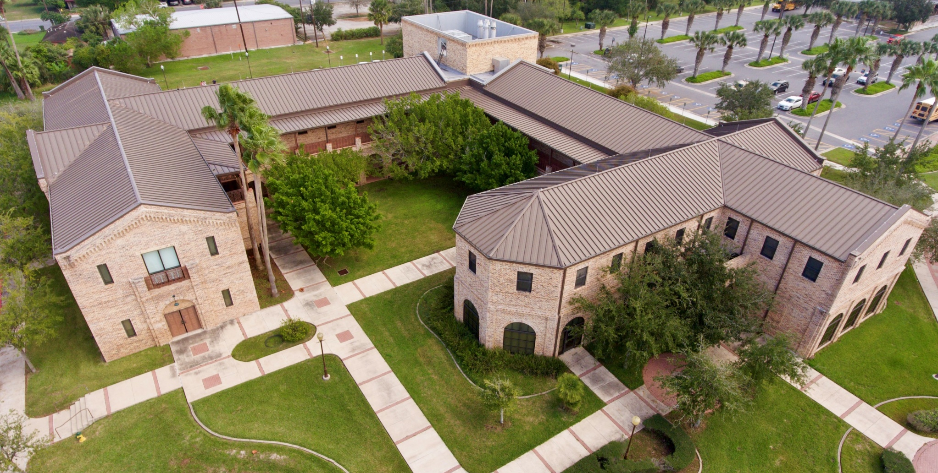
Brownsville Campus 780 Ringgold Rd. Brownsville, Texas 78520

